Slide 1
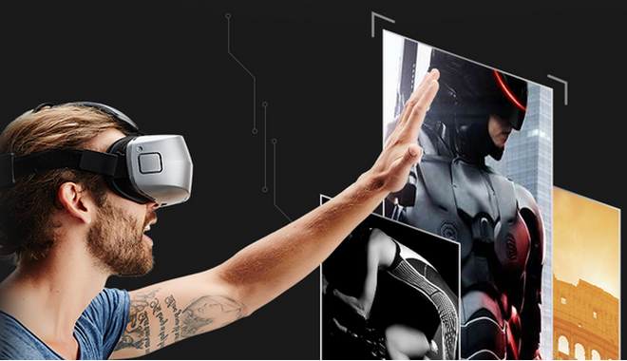

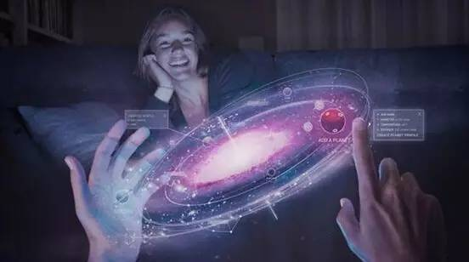
The interactions of Virtual Reality In education game
DUAN XIAOYUN
20160707

Slide 2
Virtual Reality
What is Virtual Reality?
Definition
History
Devices
VR Devices Classification
Applications
Application Fields
Entertainment
Game
film and television
live show
…
Educational application
VR educational game
School education
Professional skills training
scientific research

Slide 3
Interactive mode of VR (games)
Reference frames
Modes
Input
Tracking
Body ; head; hand…
Affective Computing
gesture – posture – voice – eye gaze – breathing – pulse & blood pressure – electrical activity of muscles – skin conductance…
Feedback(output)
Display
Input and Output
Haptics
Compare of different interaction mode
Leap motion, Nimble sense ,诺亦腾Noitom, Priovr, Control VR, Dexmo、Kinect, Omni …

Slide 4
What is Virtual Reality?
Definition
Virtual Reality , VR for short, is commonly used by the popular media to describe imaginary worlds that only exist in computers and minds
A computer-generated digital environment that can be experienced and interacted with as if that environment were real, VR is Communication --<the VR book>
Virtual realities artificially create sensory experience, which can include sight, touch, hearing, and smell—[Joseph Isaac]
In a nutshell – VR is an immersive interactive system

Slide 5
VR Devices
Composition of the VR devices
Display device
PC + VR
Mobile + VR
VR All in One - Virtual Reality All-in-one Headset
Input & feedback (interactive) devices
Operating equipment(Gamepad, joystick)
Detection equipment( capture gestures)
Other equipment(ear phone, etc.)
The filming equipment

Slide 6
* VR All in One
Wireless ; real-time processing ; light volume
Make VR devices universal standard
Sulon Q VR/AR headset powered by AMD
LingVR(DS1)

Slide 7
Display devices
PC + VR
Mobile + VR
Cardboard, Gear VR
VR All in One
Ling VR , Sulon Q
Oculus, HTC Vive

Slide 8
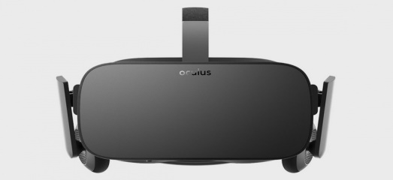
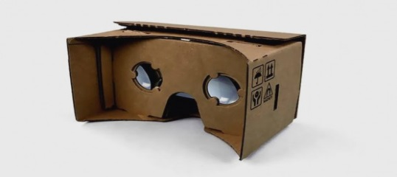
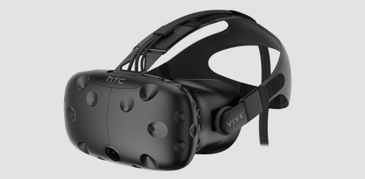

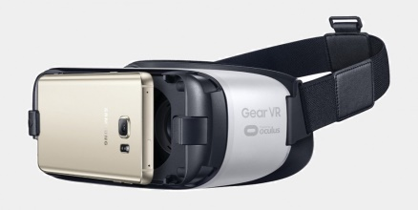
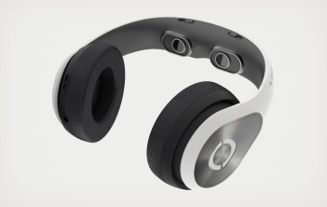
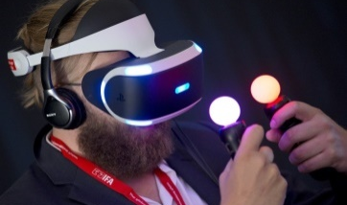
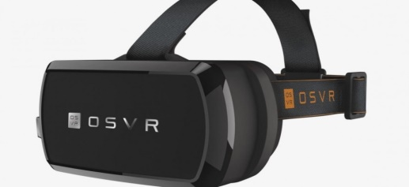
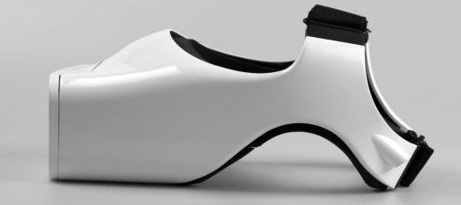
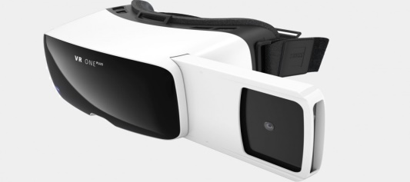
VR display devices
Oculus | Cardboard | HTC Vive
HTC Vive | Gear VR | Glyph | Play station vr
OSVR | FOVE VR | Zeiss VR One Plus

Slide 9
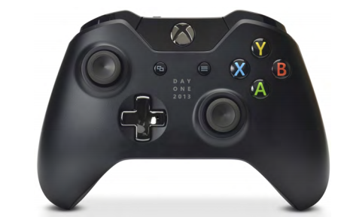
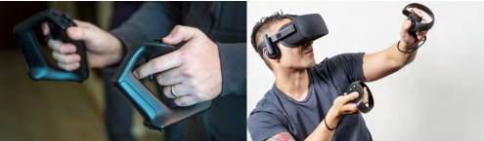
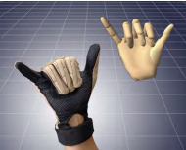
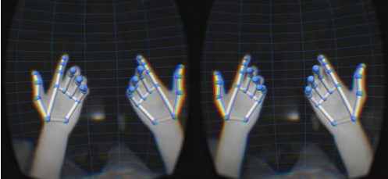
Input & feedback (interactive) devices
Each feasibility study in education situation (실행 가능성)

Slide 10
Input & feedback (interactive) terms
Head tracking; body tracking; hand tracking
gesture – posture
voice
eye gaze
breathing – pulse & blood pressure – electrical activity of muscles – skin conductance…

Slide 11
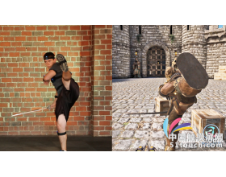
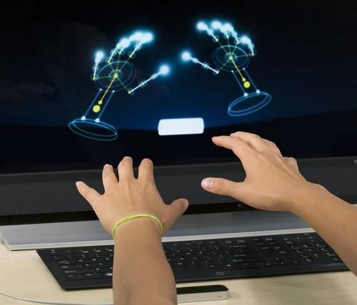
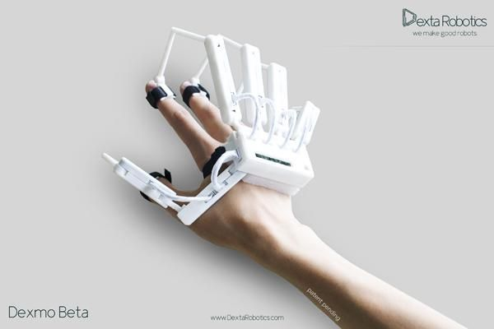
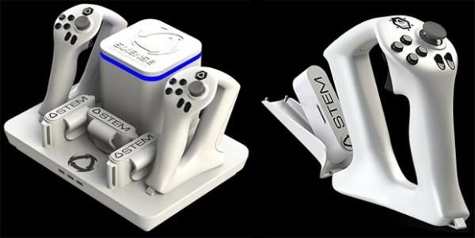
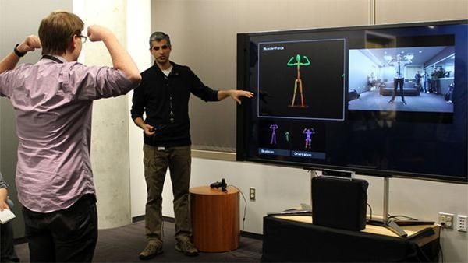
Interactive Tracking devices
Leap motion、Nimble sense 、诺亦腾Noitom、Priovr、Control VR、Dexmo、Kinect、Omni
PrioVR
Leap motion
Dexmo
Stem
Kinect

Slide 12
Applications
VR is applied in video game , film and television, Art Performance, live show, social contact, education, Tourism, ...
Educational application
VR in School education
compared to traditional teaching mode more interesting and intuitional
access to some type of mobile VR device is affordable for many more individual users and, in turn, many more schools
VR in Professional training and scientific research
training skills in a way low cost, more safety, more freely.
VR in Online Education
with the support of internet, people can learn wherever and whenever they want. Just think, learn skills that necessary hardware are require, students in remote mountainous areas may don’t have equal conditions with ones live in big city
The natural sciences, humanities history, language, and physical, chemical fields.

Slide 13
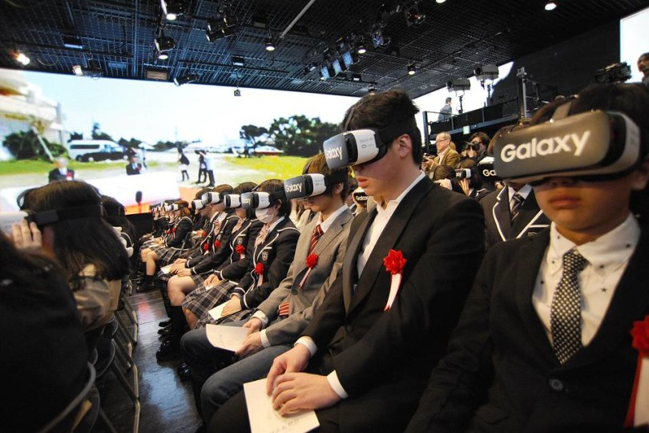
In Japan, Online Students Attend First Day of School in VR

Slide 14
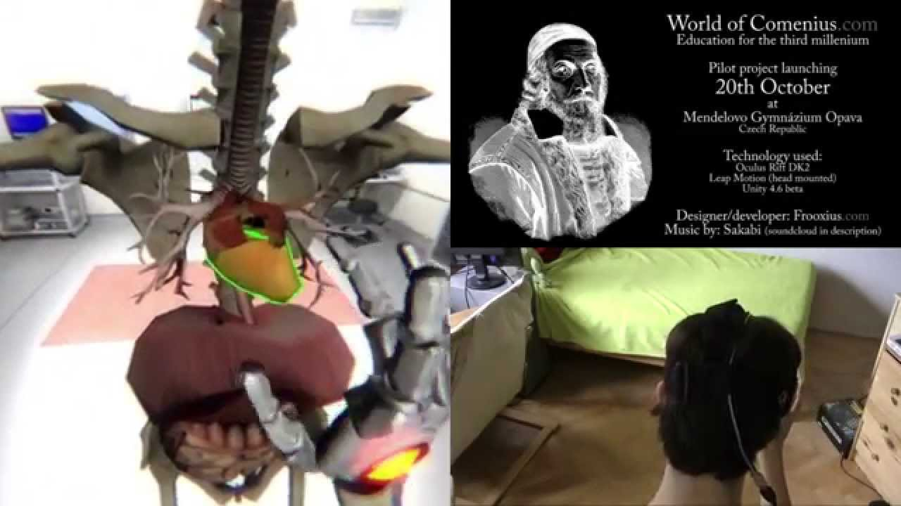
World of Comenius - Opava Pilot - Sneak Preview
https://www.youtube.com/watch?v=-W18BylZk6o
a biology lesson at a school in the Czech Republic that employed a Leap Motion controller and specially ­adapted Oculus Rift DK2 headsets, stands as an exemplary model of innovative scientific learning

Slide 15
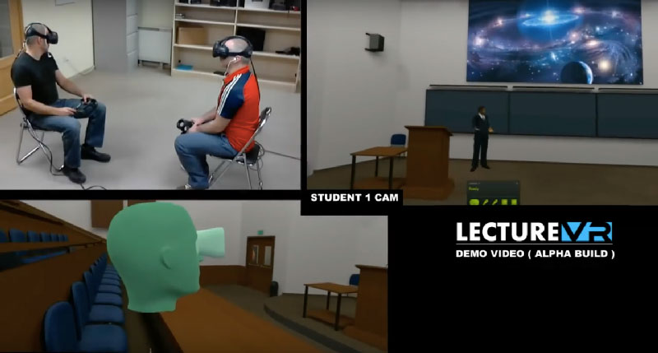
Lecture VR
Imagine sitting in a lecture room with Einstein as he talks about the Theory of Relativity

Slide 16
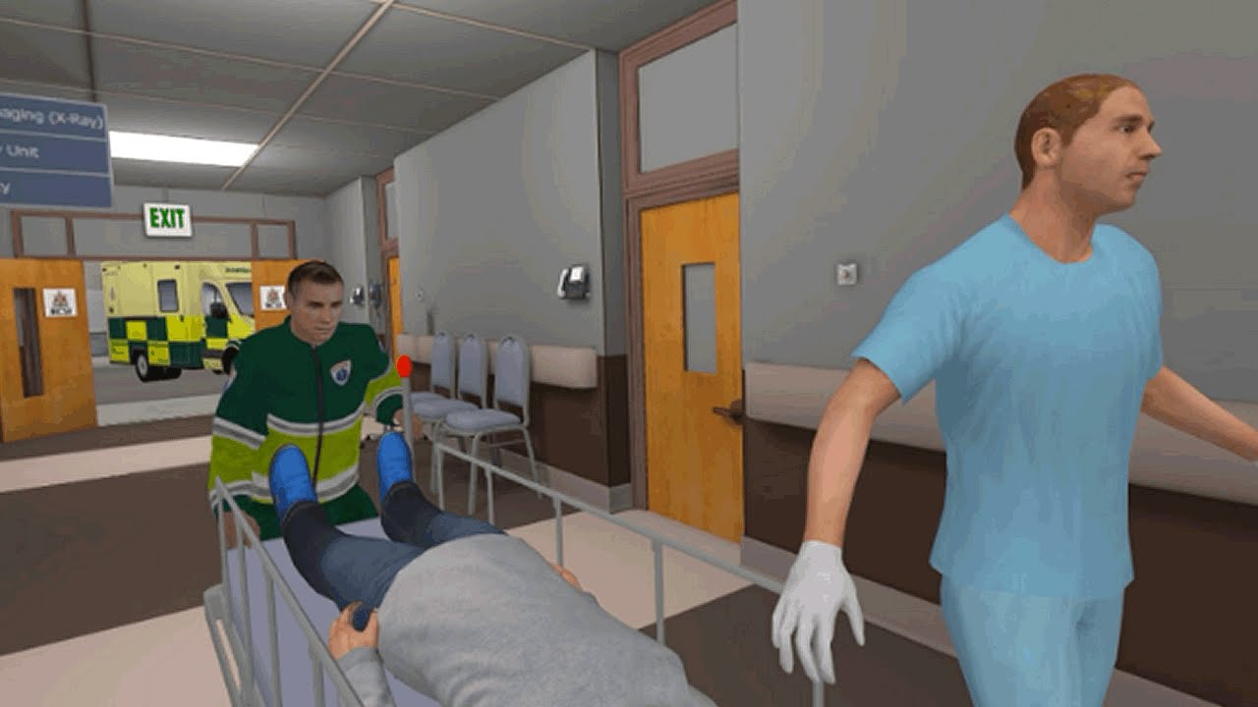
ER VR Trailer
https://www.youtube.com/watch?v=8F_PeHVSVCo

Slide 17
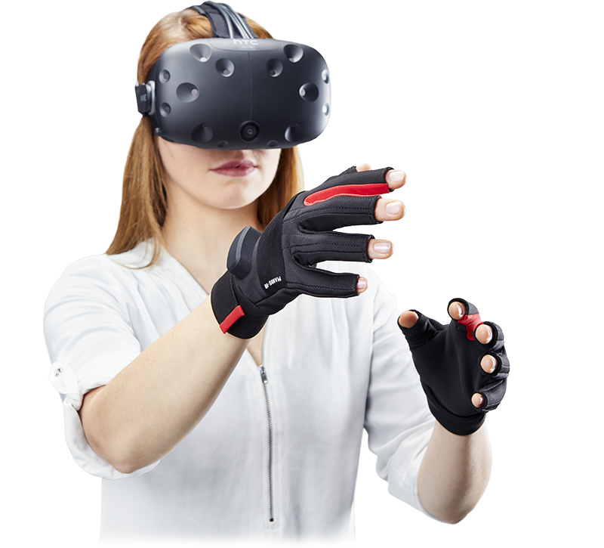
HMD
Ear Phone, Microphone
Data Glove
Data Suit
GPU

Slide 18


Slide 19
Display device
Interaction device
Tracking device
Sensing
device
VR System

